Slide 1

Ideathon
The Marathon of Ideas

Slide 2
Tips for Facilitators before starting any Session
Objective: Think about how you will INSPIRE your students and consider what you want them to take away from this exercise
Learning Context: Review some previous lessons so that students feel prepared to learn something exciting and new today!
Anticipatory Set: Do something to really GRAB their attention! Find a really great book, use a quick video clip, or sing a song that relates to this exercise
Check for Understanding: Ask lots of questions throughout your presentation to make sure students are feeling comfortable with all of this exciting new stuff

Slide 3
Outline
1
2
3
What is Machine Learning (ML) & its real-life use cases?
Three step pedagogy of Ideathon:
Inspire
Mentor
Present
Ideas and Testimonial from GDG-Ahm
Notes:
To make sure all the students are on same page, facilitator should review some of the concepts of ML.
The next step is to INSPIRE students to take part and Think! Tell them amazing applications.
Then mentor each team one-on-one. MAke sure they are thinking in the right direction.
Let them present their work in front of audience, give them positive reinforcements and feedback.

Slide 4





Machine Learning
Collect Data
Predict
Focus on User
Define Objective
Train and Test Model
System learns patterns from data
Notes:
Say to the students, "A complementary approach when developing software is Machine Learning. This is a system which learns from data rather than being explicitly programmed to via a rule".
Machine learning includes the following steps
Focus on the user - Machine learning, like any other type of software development approach requires you know who you are designing for.
Define the objective - Machine learning cannot tell you what to do with the data, the system can only do what it's been designed to do. You'll need to decide what your objective is and how you'll measure it.
Collect data - It's been said that if Machine Learning is a rocket then data is the fuel. In order for the system to learn from examples, you'll need data.
Train and test model - The system is going to look at the data and attempt to come up with a way to meet the objective set in the 2nd step. This could be a decision tree, an equation, or some other pattern learned from the data.
Predict - The system applies the model to new data and makes a prediction based on previous examples. The programmer then measures how well it met the objective and continues to refine the system over time.

Slide 5
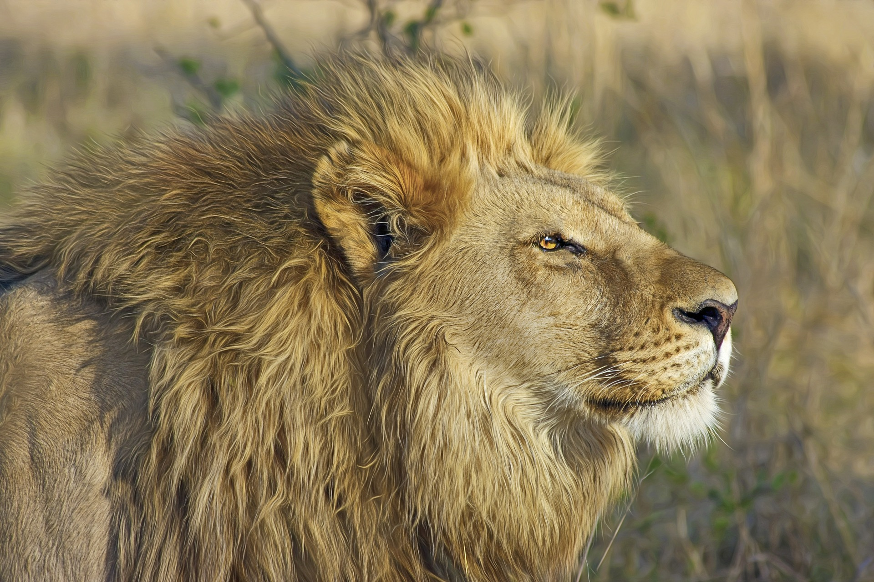
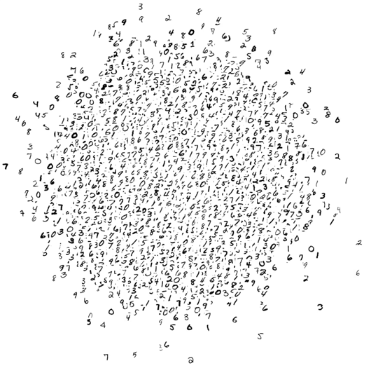
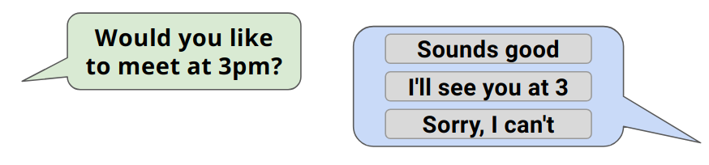
Review: What can ML be used for?
Types of
Machine Learning
Classification
Clustering
LION
WILDLIFE
Recommendation
MAMMAL
How many examples of Machine Learning can you brainstorm?
Notes:
Once the categories have been revealed, give students 3 minutes to create a brainstorm of types of Machine Learning.
This should be completed on large pieces of paper with board pens, but could be completed electronically if resources aren’t available.
The task can be completed as an independent or collaborative task, depending on the preference of the facilitator.

Slide 6
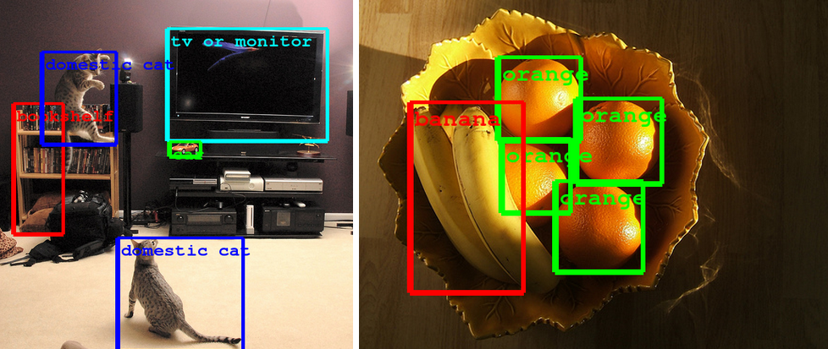
Image Recognition
Use to detect individual features / components of an image.
Notes:
Facilitator to describe the technology seen in the picture. Can students think of any other instances where this technology would be useful?
Try to link to autonomous cars, robotics etc.
Image

Slide 7
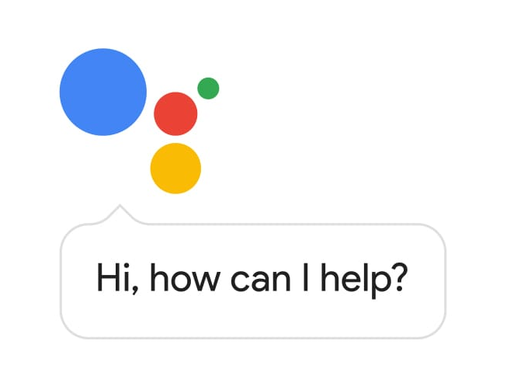
Speech Recognition
Translating spoken word to text (Transcribing)
Language detection
Notes:
Facilitator to describe speech recognition. Can students identify why this is useful? Where have they seen / used this already?
Image (left)

Slide 8
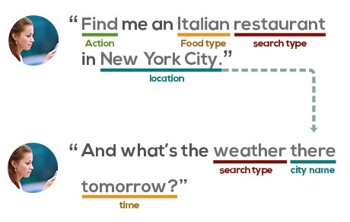
Natural Language Understanding (NLU)
Being able to understand and respond to language.
Notes:
Facilitator to describe Natural Language Understanding ML - where have students seen examples of this technology. Facilitator should give students the opportunity to explain their understanding of NLU
Image

Slide 9
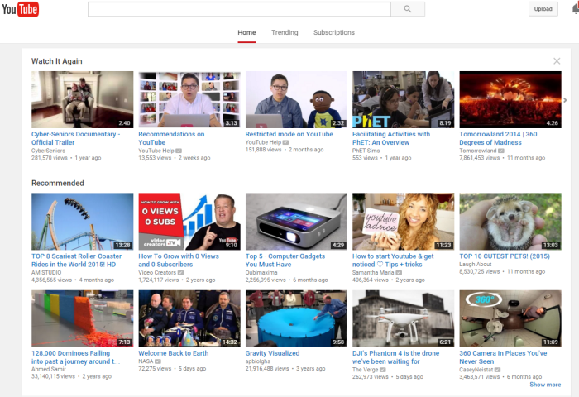
Personalized Recommendations
YouTube recommendations.
Learning and predicting what a user might like.
Notes:
Facilitator to describe Personalised Recommendation ML. Can students describe any similar examples?
Discuss how the process of manually selecting recommendations would be a large task to do for lots of people. Emphasise efficiency of using Machine Learning.
Image

Slide 10
When to use ML?
Alphabetizing a list of song titles
Not ML
Ranking web search results
Both
Predicting housing prices from location data
ML
Processing online payments
Not ML
Recognizing an object in an image
ML
Creating a computer player for an Xs Os game.
Not ML
Creating a computer player for a chess game.
Both
Notes:
When to Use ML?
Ask the students which method would be ideal for applying machine learning or traditional programming.
Click to reveal each answer then click again to reveal the next line.
Explanation for each row:
Alphabetizing a list of song titles
not ML
It is a straightforward task that can be accomplished with traditional sorting algorithms.
Ranking web search results
Can be accomplished with both methods
It is both because one could use an algorithm like PageRank to rank results as Google did for many years but Machine Learning could be used to rank and recommend results to a user.
Recognizing an object in an image
ML
The number of possible objects is too large to efficiently use traditional programming. Machine Learning can make this process more efficient by learning patterns such as the wheel on a car rather than needing to scan every pixel.
Creating a computer player for an Xs Os game (aka Tic-Tac-Toe)
Not ML
The space of potential moves and rules of the game are small enough to be captured in a succinct algorithm.
Creating a computer player for a chess game.
Both
There are many traditionally programmed chess algorithms that are able to compete at an expert level. A sufficiently well trained machine learning system could have enough learned intelligence to compete in situations it has not seen before (see AlphaGo).

Slide 11
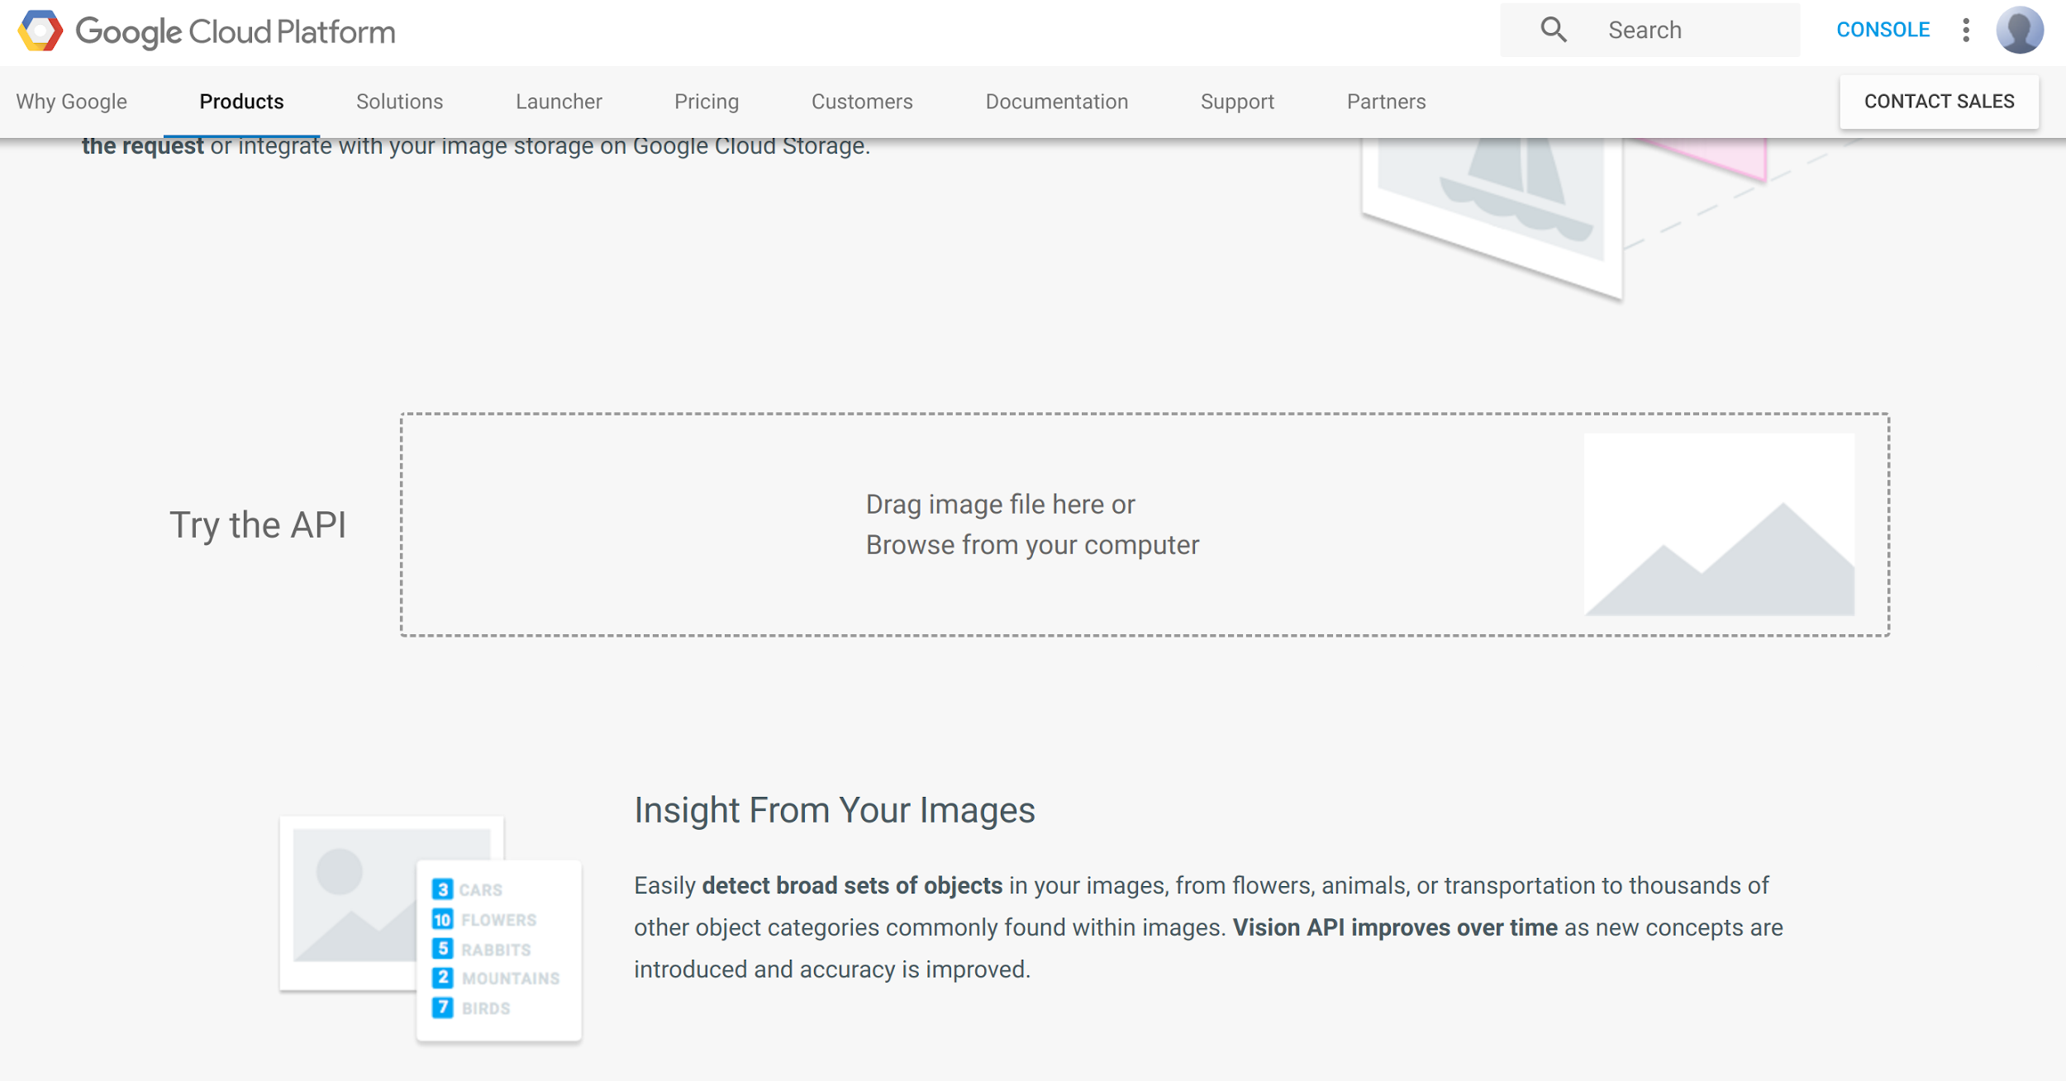
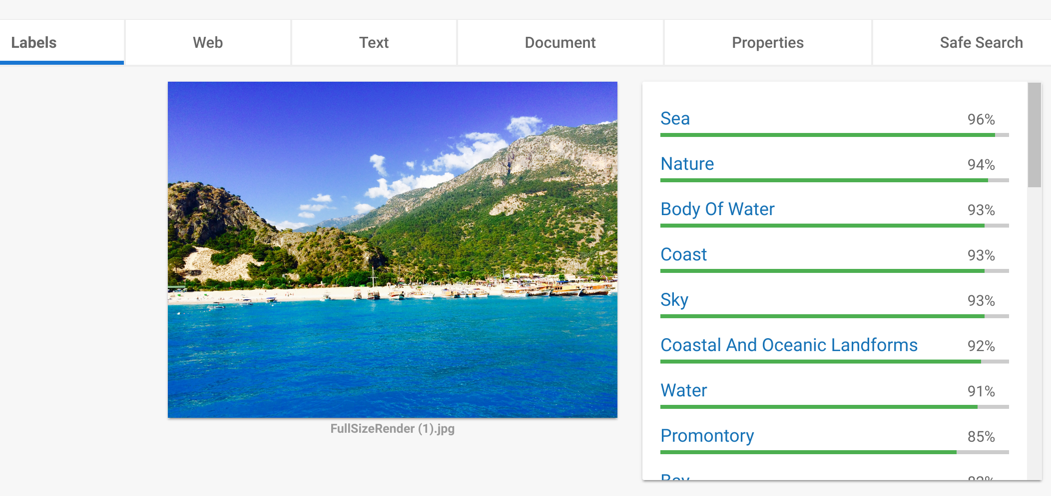
Demo: Vision API
cloud.google.com/vision/
Notes:
Screenshots taken from link above.
The first API we will look at is the Vision API. It can be used to identify the things that might be in an image.
Demo loading up the web address. Show the class where the API test box can be found and upload a sample picture. Click through the tabs to show the class the different pieces of data returned by the API.
We can click through different pieces of data returned by the API. Notice that we are presented with a series of labels or descriptors. Each label is accompanied with a percentage of the likelihood that it is in the image. The API can never be 100 percent certain that something is in an image, but it can be highly certain.
Take some time now to try the API using the link on screen in your web browser.
Circulate the room, supporting students with using the API.

Slide 12
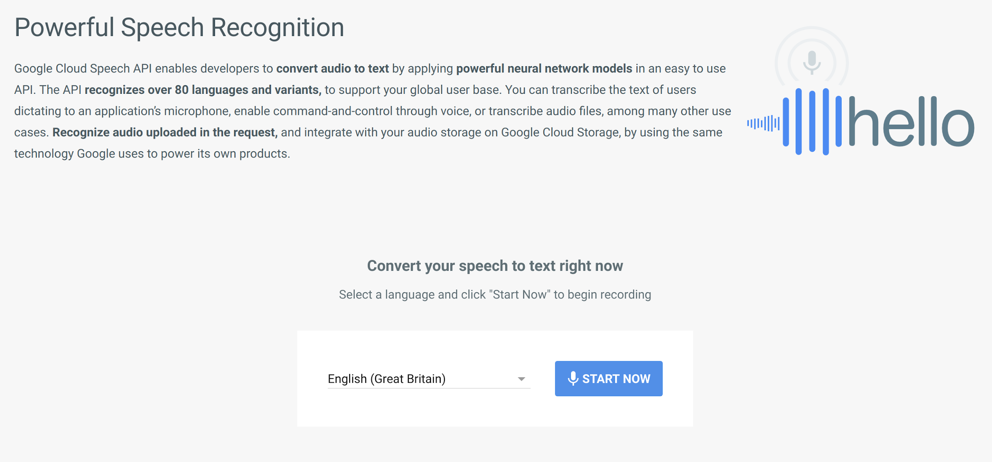
Demo: Speech API
cloud.google.com/speech/
Notes:
Screenshot taken from link above.
The next API performs a function that many of you will be familiar with. It takes an audio signal and turns it into text.
Point students to the web link. They shouldn’t need a demonstration as the UI is very self-explanatory. Allow for 2 minutes for students to experiment with the API. Encourage them to experiment with different languages / phrases / speeds of speech.

Slide 13
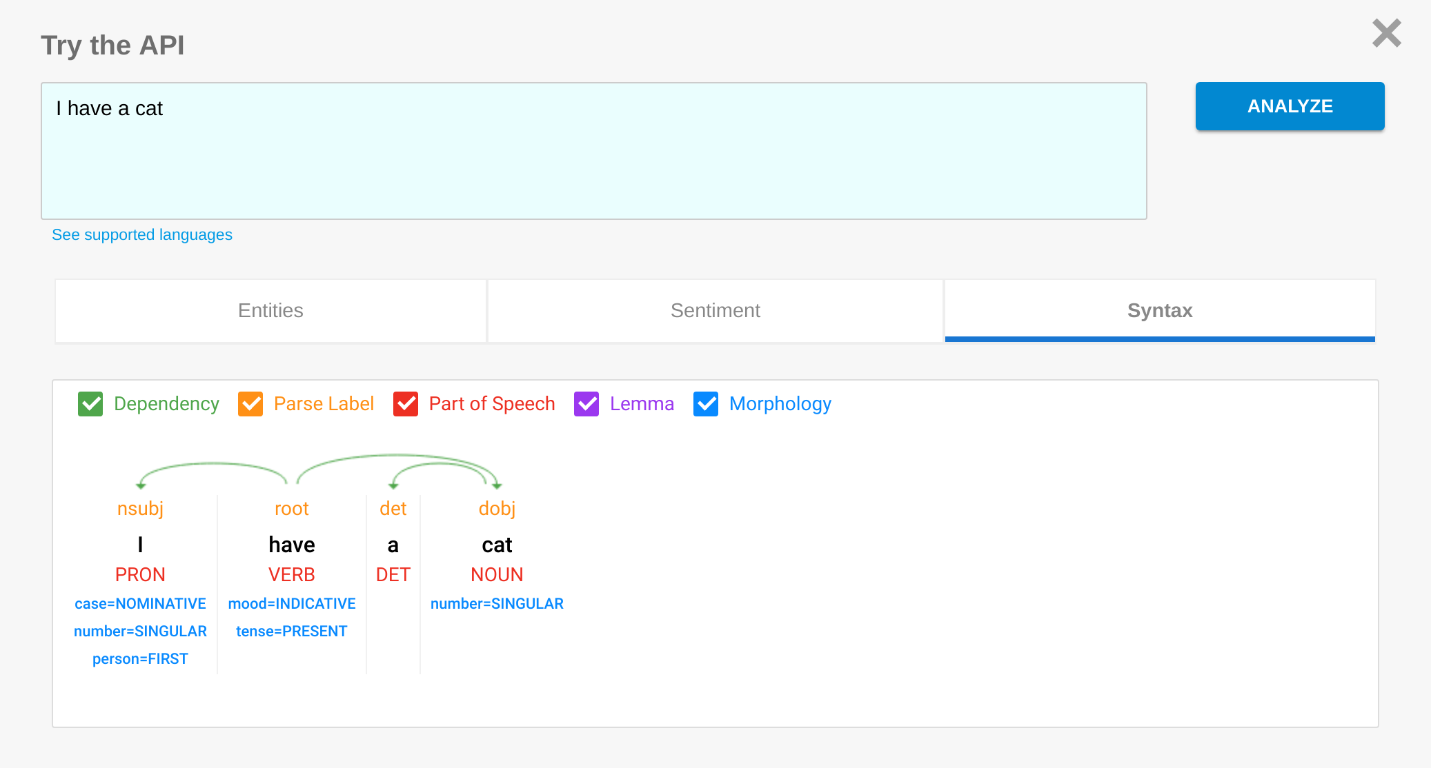
Demo: Natural Language Understanding API
cloud.google.com/natural-language/
Notes:
Screenshot taken from link above.
The final API we will look at is the Natural Language Understanding API. It is capable of breaking down a sentence and understanding the meaning behind text. This can be used in conjunction with other software to generate intelligent responses to text as seen in Google Allo.
Demo using the API to the class - it is unlikely that students will want to use this API in the practical section, however encourage them to try it out later in the class if they wish.

Slide 14

Which CloudML APIs could each application use?
Application | Vision | Speech | Natural Language
Identifying which images in an album of an event contain happy people, so these can be uploaded
Analysing tweets about a new product to get immediate data on what people think
Identifying in real time if a caller to a radio show has used inappropriate language
Searching through a library of scanned book images to find mentions of Machine Learning
Providing music recommendations based on the songs the user has been listening to recently
Using voice control to tell a phone to take a group photo, and retake if anyone has their eyes closed
Notes:
This quiz is to check students’ understanding of ML concepts. Click to show the next question, then ask students which of the APIs each application could use, then click again to reveal the answer.
The second-last question is unlikely to use any of the APIs discussed; it is worth emphasising that not all machine learning applications simply use these APIs!
Tick image is open source

Slide 15
Topics for Inspiration
DAY-TO-DAY LIFE
What solutions and changes can Machine Learning make our everyday life better?
MOBILITY
How can ML technologies support customers in their mobility demands?
AGRICULTURE
How can ML help farmers and create an impact beyond their daily requirements?
HEALTH CARE
How can ML help doctors solve complex medical issues?
EDUCATION
How can ML augment schools with better learning experiences?
Notes:
Explain the application view of using ML concepts like NLP, CV etc. which can make our life easier and give them direction to start thinking on.

Slide 16

Brainstorm
How could machine learning be applied to the ways you use a computer* each day?
* Laptop, phone, tablet, etc.
Notes:
Say to the students:
Say to the students, "With the person seated next to you, brainstorm a list of ways ML can help you”
After this brainstorming is complete, have students raise their hands to share the list of tasks they created.

Slide 17

Finalize Your Idea
Spend 2 minutes agreeing as a group what your final idea will be.
Notes:
Say to the students, “With the person seated next to you, brainstorm a list of ways you can use ML to ease your life”
After this brainstorming is complete, have students raise their hands to share the list of tasks they created.
Write these as a list on the whiteboard or keep track of them somehow, as you will refer to them at the end of the session.

Slide 18

Sharing Your Ideas
Each group takes about 30 seconds to share their idea.
Notes:
Say to the students, “With the person seated next to you, brainstorm a list of ways you can use ML to ease your life”
After this brainstorming is complete, have students raise their hands to share the list of tasks they created.
Write these as a list on the whiteboard or keep track of them somehow, as you will refer to them at the end of the session.

Slide 19
Keep building your Ideas!

Slide 20

Presenting Your Ideas
What is the Problem Statement?
What is your Motivation behind choosing this idea?
Talk about your assumptions of Dataset
Explain Feature selection
Explain your Algorithm/Approach
What successes can we achieve?
What challenges did you face?
Notes:
The image is open source
Ask student’s to focus on following questions while presenting their ideas to the audience.

Slide 21
Ideas from GDG Ahmedabad

Slide 22
Idea: 1
Problem Statement by Sapan Zaveri & Yash Thakkar
Smart garbage detection and collection in Indian context
Motivation
Many place in India are untidy and not clean. This will result in disease or cause health issues. The garbage are thrown at one place and it affects nearby residential or public places. The untidiness is the root cause of mosquitoes and will result in dengue, malaria etc. disease.
Dataset
Use of satellite image or drone camera for identifying garbage.
Approach & Outcome
Using clustering and image processing, we can identify the garbage We can classify garbage as renewable or nonrenewable. Due to this, we can reuse it and maybe utilise in further as we know that we can generate energy.

Slide 23
Idea: 2
Problem Statement by Juhil Somaiya & Ritesh Gajjar
Smart Village: Agriculture with Machine Learning
Motivation
The idea is to support the the Mission Smart Village India initiated by Government of India on Gandhi Jayanti, 2014. As we know more than 70% of revenue is generated from the field of Agriculture and also India is still under development country we should support it so that ultimately it will be a stepping stone towards the development of the nation.
Methodology / Output
With help of sensors and computer vision we will collect data on daily basis such as color of the crop, soil moisture, soil water, quality of fertilizer, atmosphere gases etc. By analysing collected data we can predict the best environment of any crop. If any irregular conditions like soil erosion or water problems occurs then alerts will be sent to the farmers.
Features
Daily monitoring and photo capture Future precautions
Analysis and generation of reports Alerts on not suitable conditions

Slide 24
Few more Ideas
Smart Selection of Dream11 during IPL
Build a model using ML, Data Analysis and NLP which can select best 11 players for each IPL Matches
Anomaly detection in Tweets
Prevent unnecessary fishing in tweets using web scraping and building model in NLP which has features like time between consecutive tweets, number of followers and followings, interest and hobbies of a person, time of the tweet etc.
Automated Recruiting process using ML and Robotics
A robot will replace/reduce the word done by a HR by filtering “Good” candidates from the pool by analysing their Resumes, cover letters etc.
Corruption Preventing Smartcard (CPS)-to filter duplicate tendering
CPS will have individual data of all the partners. Link CPS + Adhar Card + Pan card to have all the details and validate them to auto discard entry of tender filed via partner

Slide 25
Testimonial
Charmi did a fantastic job in explaining every topic. I really appreciate her effort and time she spent on teaching us. It was fantastic MLCC program and Ideathon organised by GDG Ahmedabad. In just two study jam meetups, I am able to write small programs on ML, This was all due to hands on and personal teaching provided in meetup. Again thank you to the organisers, speakers and GDG for this wonderful event. -Sapan Zaveri
By attending and understanding the MLCC study jams and Ideathon, I get to know about Machine learning and now I can say I can build my own algorithms and can work on it. Specially thanks to Google Developers Group, Ahmedabad and tutor Charmi Chokshi for providing such an event. -Juhil Somaiya

Slide 26
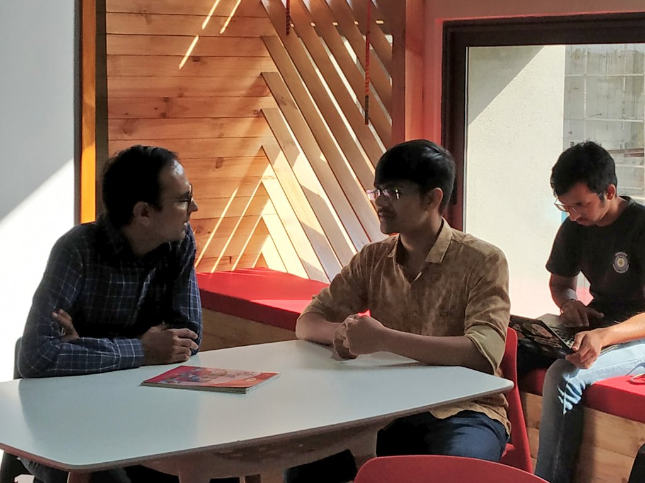
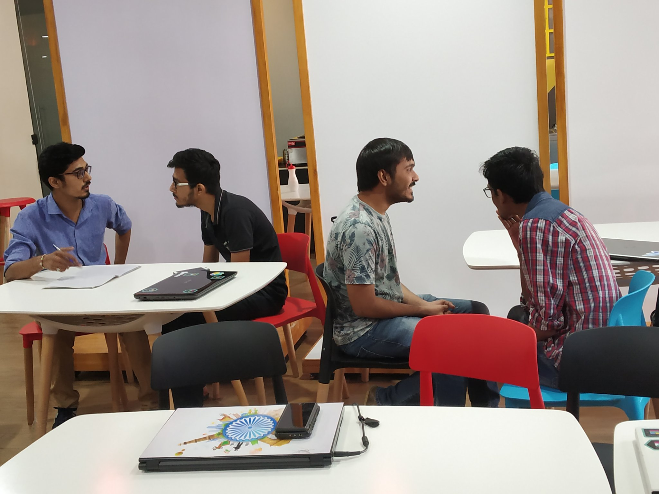
Ideating in Progress!

Slide 27
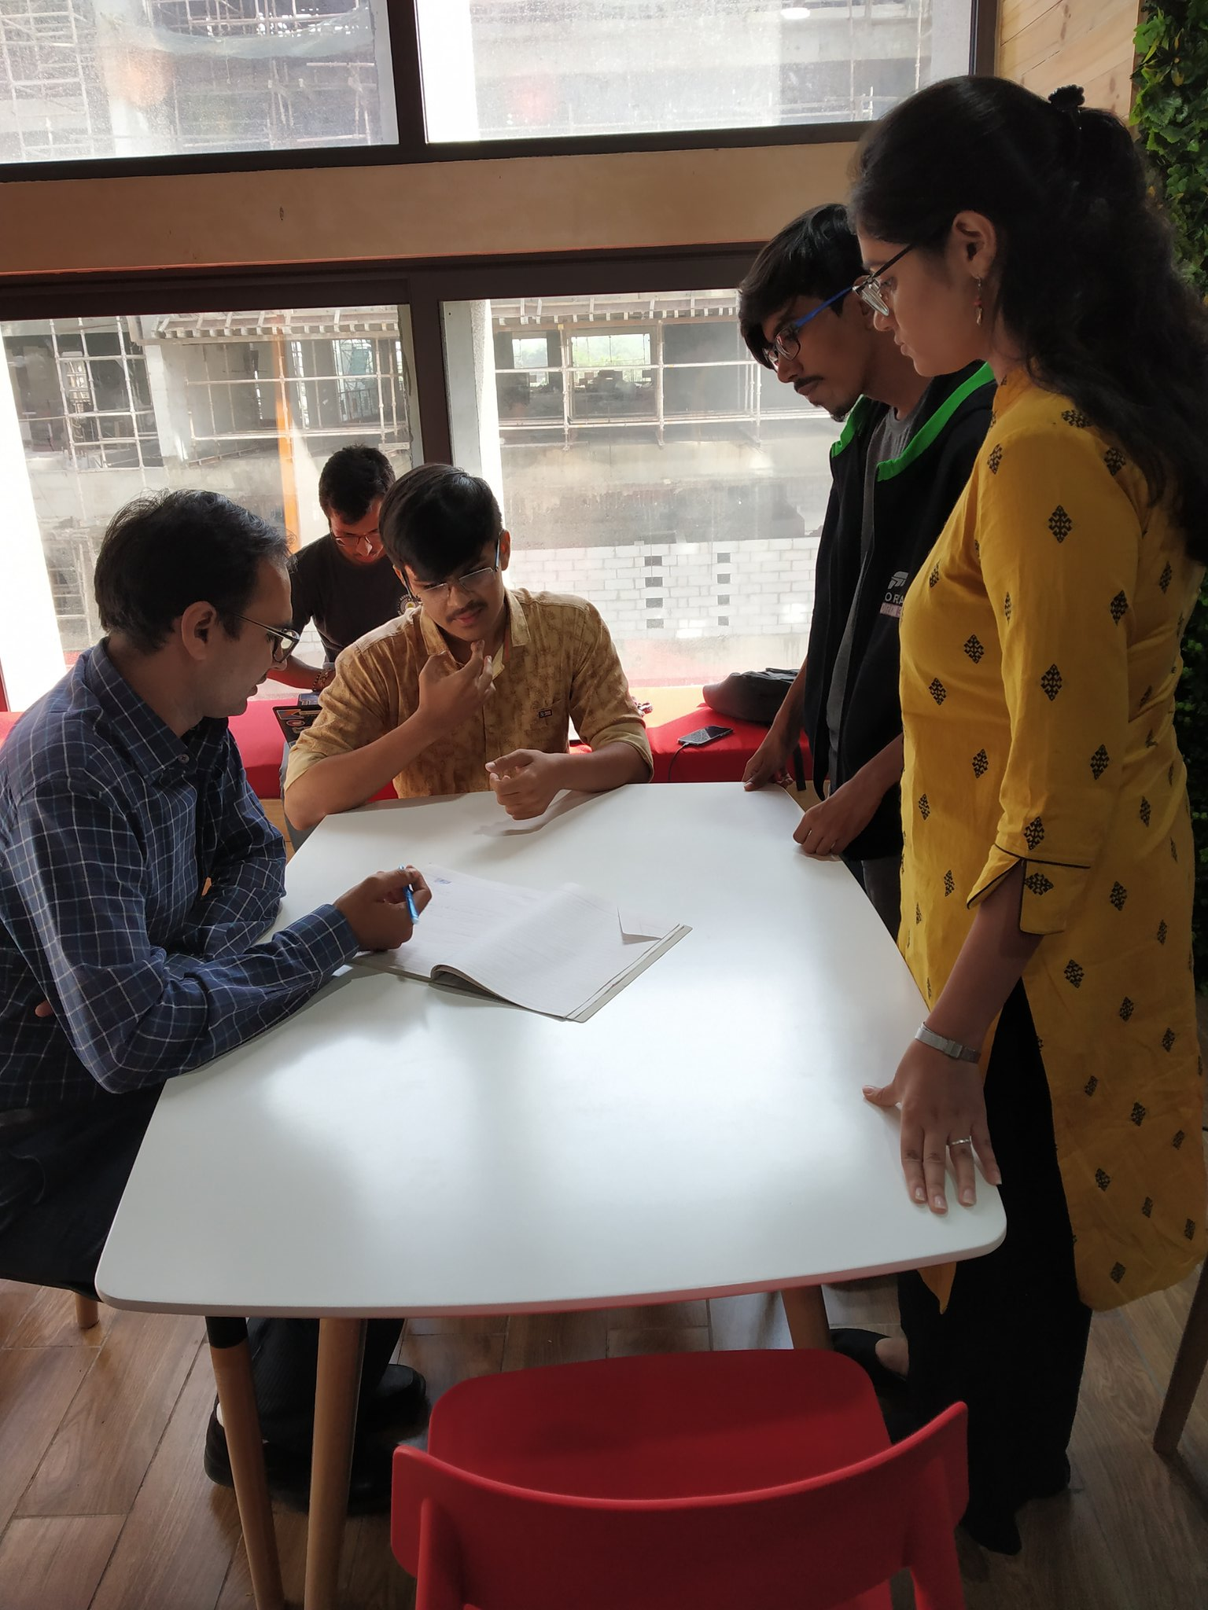
One-on-one Mentoring

Slide 28
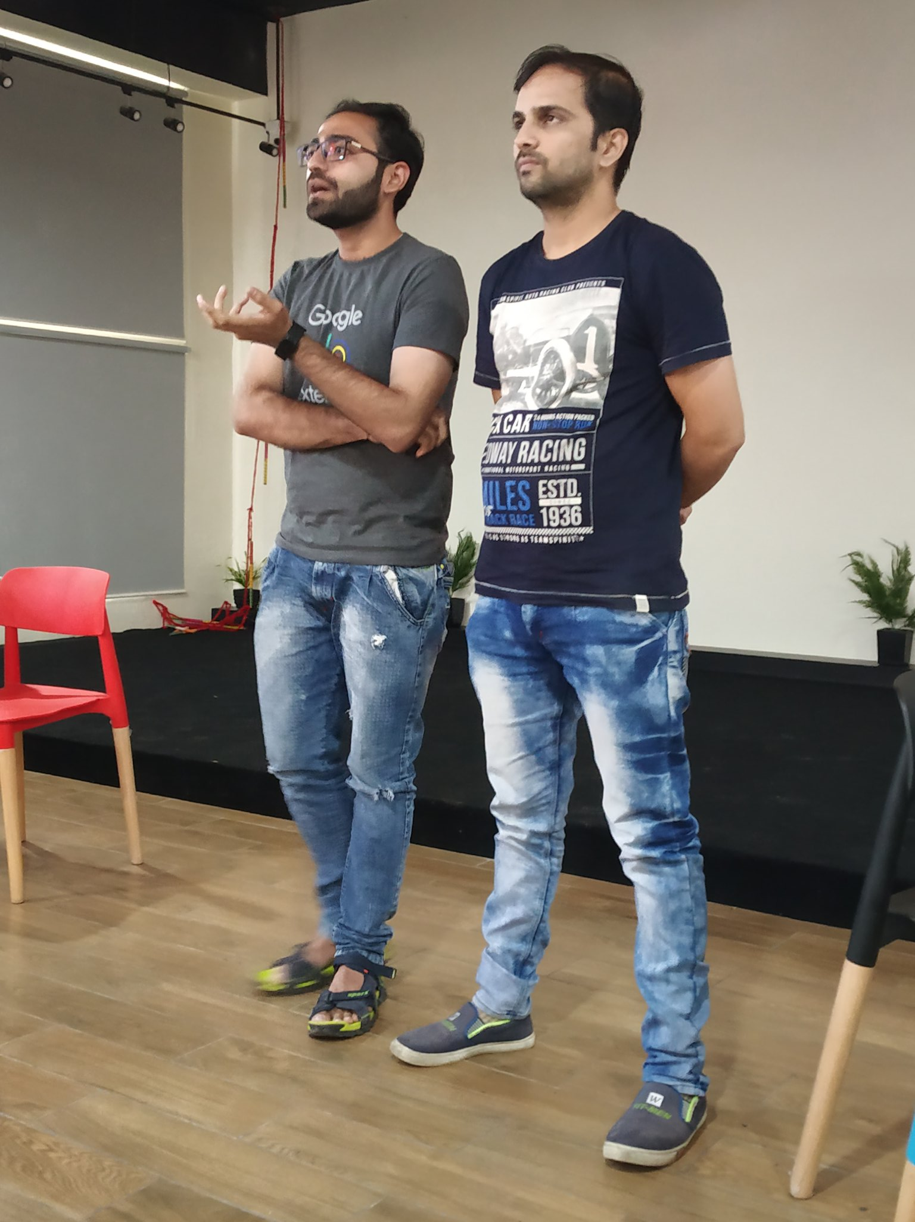
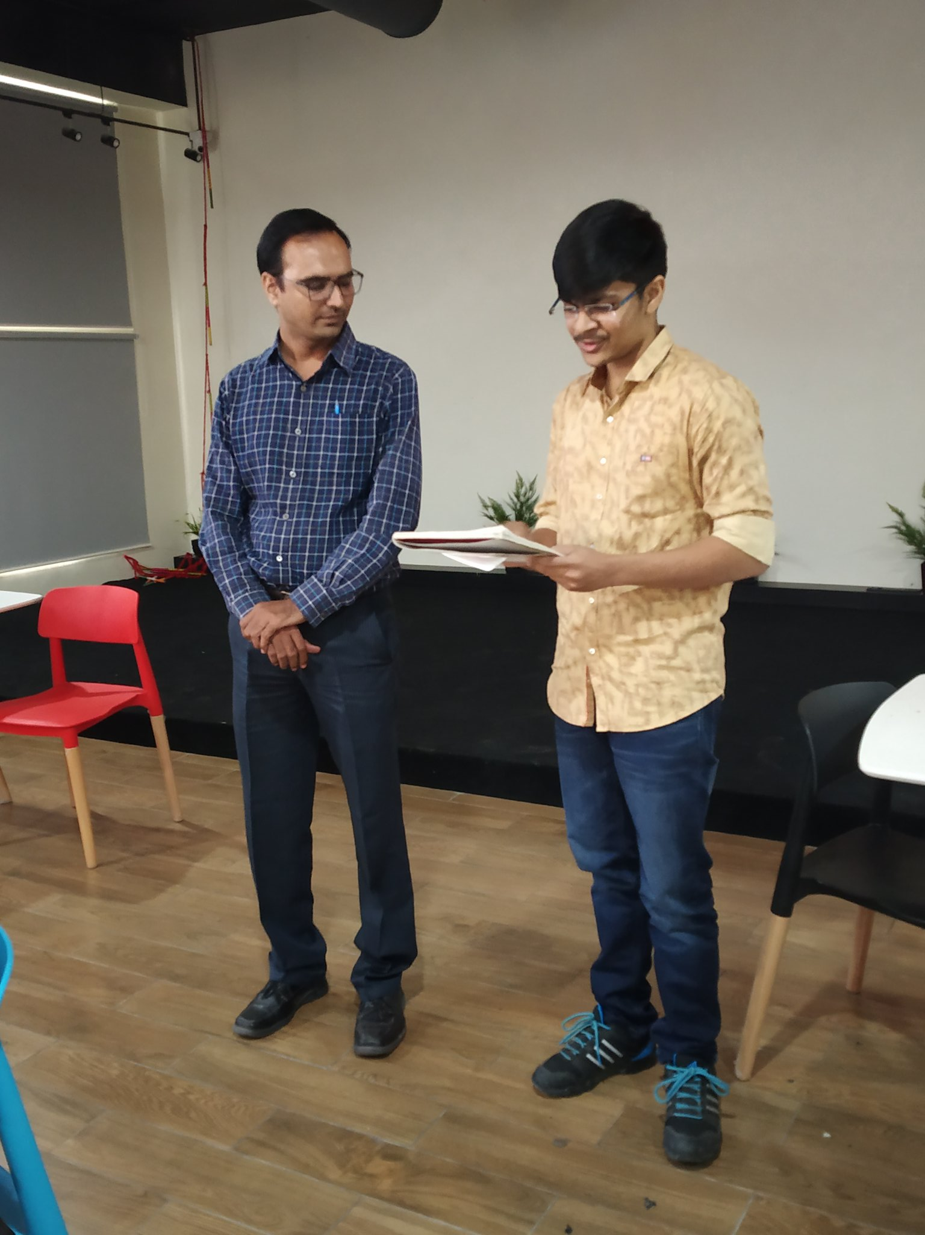
Participants Presenting their Master Plans!

Slide 29


